Slide 1

Algorithm Analysis and Design Course Project
First Semester 2022/2023
Teamwork:
Reem SH. Almualem
Danah AlMuzel
Luluwah Waleed
Warood Alzayer
Hana Alomran
Areej Ahmed Saleh
Supervised by:
Dr. Azza A. Ali

Slide 2
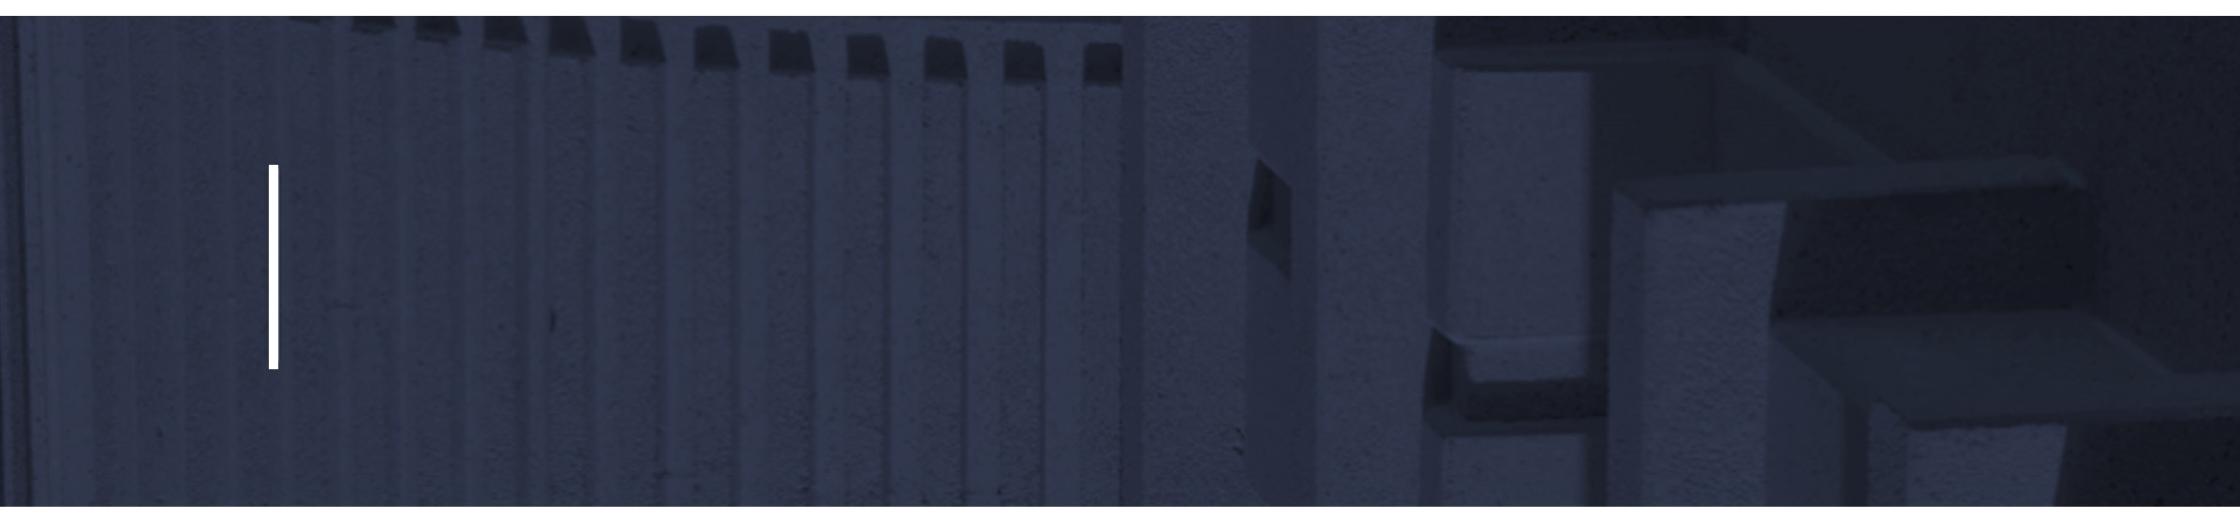
Agenda
Introduction
Implementation
Problem Solving and Analysis
Discussion

Slide 3
Introduction

Slide 4
Device Characteristics
Random Access Memory (RAM) | Central processer unit (CPU) | Operating System (OS) | System Type
8.00 GB (7.78 GB usable) | 11th Gen Intel(R) Core (TM) i5-1135G7 @ 2.40GHz 2.42 GHz | Windows 11 | 64-bit operating system, x64-based processor

Slide 5
Timing Machine
startTime = System.nanoTime();
Insertion inerstion = new Insertion(clone1);
stopTime =System.nanoTime();

Slide 6
Input Selection
Input Sizes : (100, 500, 1000, 5000, 10000, 50000, 100000, 200000)
Input Types:
Increasing
Decreasing
Random

Slide 7
Implementation

Slide 8
Insertion Sort Algorithm
Insertion sort is a sorting algorithm that places an unsorted element in the proper location after each iteration. Insertion sort functions similarly to how we sort the cards in our hands when playing cards. Given that we know the first card is already sorted, we choose an unsorted card.
6
10
24
Cases | Best Case | Average Case | Worst Case
The order of data | Data sorted increasingly. | Between best and worst case. | Data sorted decreasingly.
Time complexity | T(N)=∅(n) | T(N)=∅(n^2) | T(N)=∅(n^2)
36
12

Slide 9
Insertion Sort Algorithm’s Theoretical and Practical
Analyze and Error Ratio
Cases | Best Case |  | Average Case |  | Worst case
Input size (n) | Theoretical Time | Practical Time (Actual Time) | Theoretical Time | Practical Time (Actual Time) | Theoretical Time | Practical Time (Actual Time)
100 | 100 | 3.353400ms | 10000 | 1.950500ms | 10000 | 1.399800ms
500 | 500 | 4.064600ms | 250000 | 2.658800ms | 250000 | 7.462600ms
1000 | 1000 | 5.933700ms | 1000000 | 7.932100ms | 1000000 | 13.781100ms
5000 | 5000 | 99.635400ms | 25000000 | 106.165300ms | 25000000 | 141.161700ms
10000 | 10000 | 294.527500ms | 100000000 | 249.206700ms | 100000000 | 461.818800ms
50000 | 50000 | 6165.683300ms | 2500000000 | 2083.697300ms | 2500000000 | 3557.153800ms
100000 | 100000 | 3564.733500ms | 10000000000 | 5442.379400ms | 10000000000 | 8168.329900ms
200000 | 200000 | 14541.174200ms | 40000000000 | 30956.249700ms | 40000000000 | 31047.511200 ms
Case | Best case | Average Case | Worst Case
Input size (n) | 𝑃/T x 100 | 𝑃/T x 100 | 𝑃/T x 100
100 | 3.5% | 0.019% | 0.014%
500 | 0.8% | 0.0017% | 0.0029%
1000 | 0.5% | 0.00079% | 0.0014%
5000 | 1.9% | 0.00042% | 0.00056%
10000 | 2.9% | 0.00025% | 0.00046%
50000 | 12.3% | 0.000083% | 0.00014%
100000 | 3.5% | 0.000054% | 0.000082%
200000 | 7.2% | 0.000077% | 0.00000077%

Slide 10
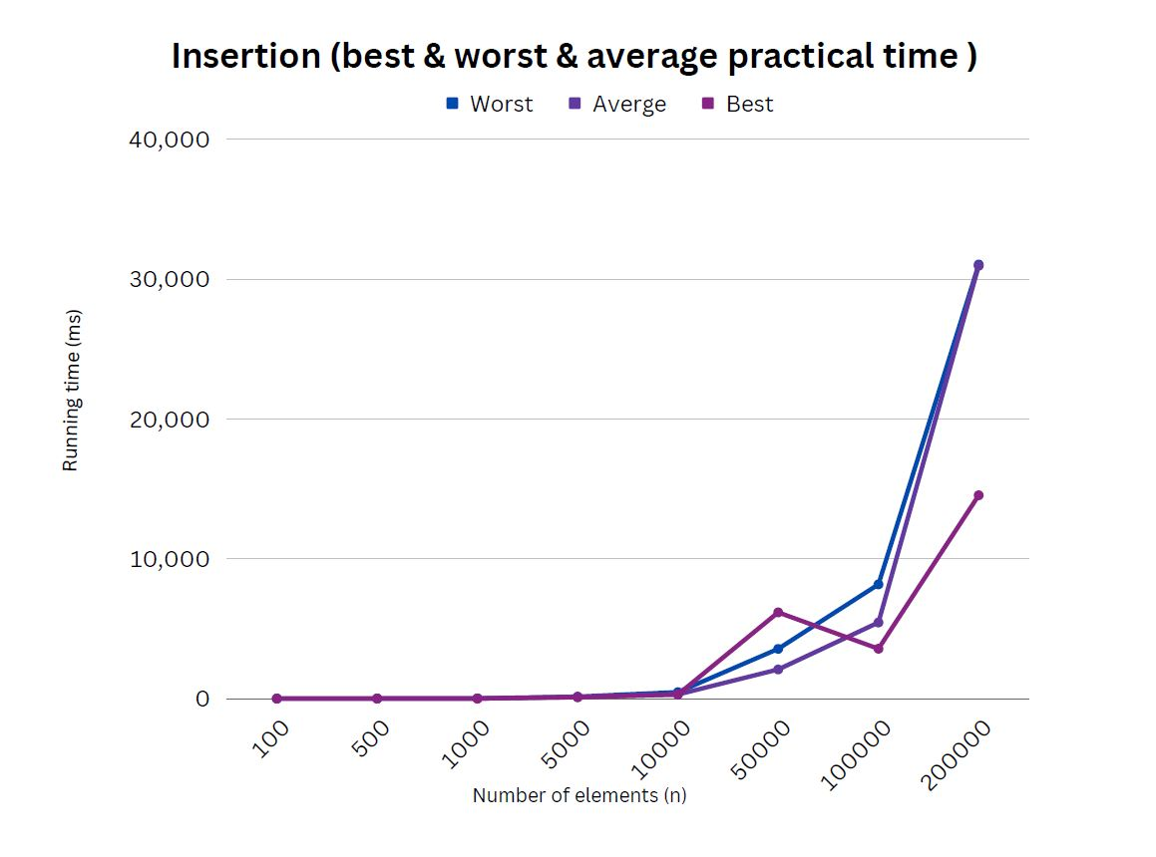
Insertion Sort Algorithm’s Cases Comparison Graph

Slide 11
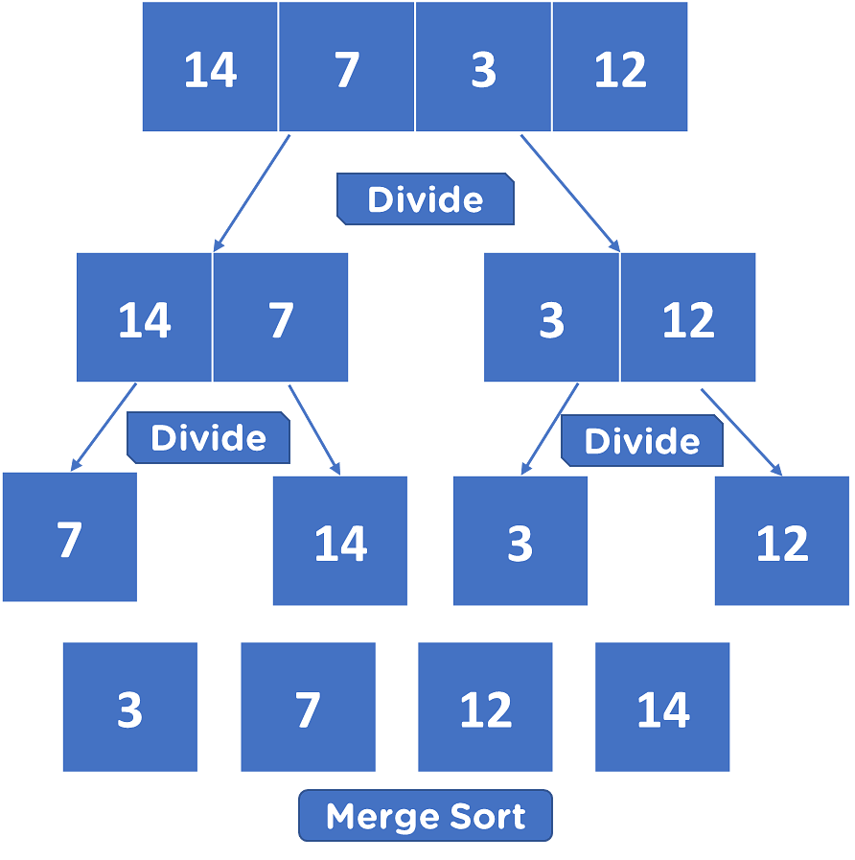
Merge Sort Algorithm
is a method of sorting that sequentially joins list items to order data. Each item in the first unordered list is combined with every other item to form groups of two. There is one ordered list once all two-item groups have been combined, creating groups of four and so on.
Cases | Best Case | Average Case | Worst Case
The order of data | Data sorted increasingly. | Between best and worst case. | Data sorted decreasingly.
Time complexity | T(N)=∅(nlogn) | T(N)=∅(nlogn) | T(N)=∅(nlogn)

Slide 12
Merge Sort Algorithm’s Theoretical and Practical Analyze and Error Ratio
Cases | Best Case |  | Average Case |  | Worst case
Input size (n) | Theoretical Time | Practical Time (Actual Time) | Theoretical Time | Practical Time (Actual Time) | Theoretical Time | Practical Time (Actual Time)
100 | 200 | 2.914600ms | 200 | 1.204600ms | 200 | 1.134200ms
500 | 1349.485002 | 5.843700ms | 1349.485002 | 5.205600ms | 1349.485002 | 4.404100ms
1000 | 3000 | 20.230300ms | 3000 | 7.754600ms | 3000 | 11.043600ms
5000 | 18494.85002 | 261.885600ms | 18494.85002 | 277.852000ms | 18494.85002 | 293.611700ms
10000 | 40000 | 1895.638400ms | 40000 | 620.920700ms | 40000 | 2371.687600ms
50000 | 234948.5002 | 3568.189700ms | 234948.5002 | 3372.414600ms | 234948.5002 | 3429.722200ms
100000 | 500000 | 5037.861800ms | 500000 | 5130.939100ms | 500000 | 5202.545700ms
200000 | 1060205.999132796 | 15002.870700ms | 1060205.999132796 | 14316.786600ms | 1060205.999132796 | 14565.421800ms
Case | Best case | Average Case | Worst Case
Input size (n) | P/T x 100 | P/T x 100 | P/T x 100
100 | 1.4573% | 0.6% | 0.6%
500 | 0.43% | 0.38% | 0.3%
1000 | 0.67% | 0.26% | 0.4%
5000 | 1.4% | 1.5% | 1.6%
10000 | 4.7% | 1.5% | 5.9%
50000 | 1.5% | 1.4% | 1.5%
100000 | 1% | 1% | 1%
200000 | 1.41% | 1.35% | 1.37%

Slide 13
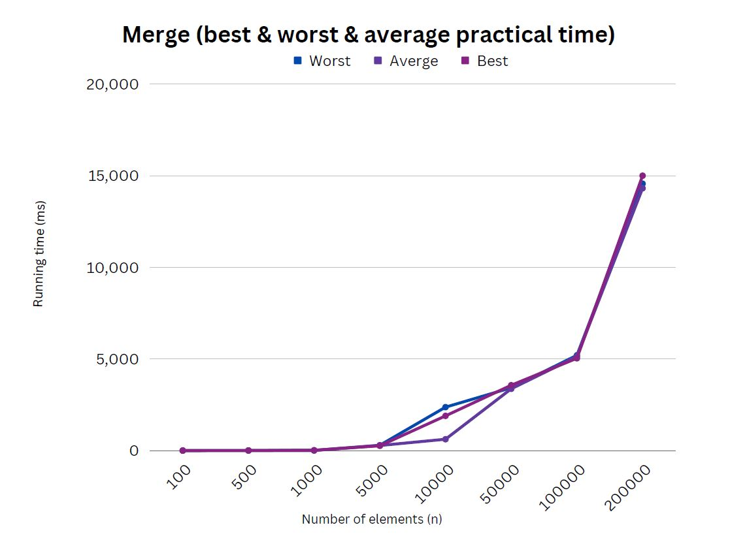
Merge Sort Algorithm’s Cases Comparison Graph

Slide 14
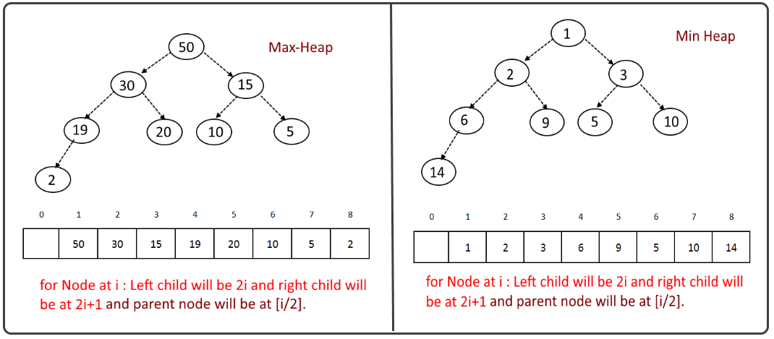
Heap Sort Algorithm
Heap sorting uses comparisons to sort data and is based on the Binary Heap data structure. The minimum element is first identified, and it is then positioned at the start. The remaining elements should be treated similarly. A built-in algorithm is heap sort.
Cases | Best Case | Average Case | Worst Case
The order of data | Data sorted increasingly. | Between best and worst case. | Data sorted decreasingly.
Time complexity | T(N)=∅(nlogn) | T(N)=∅(nlogn) | T(N)=∅(nlogn)

Slide 15
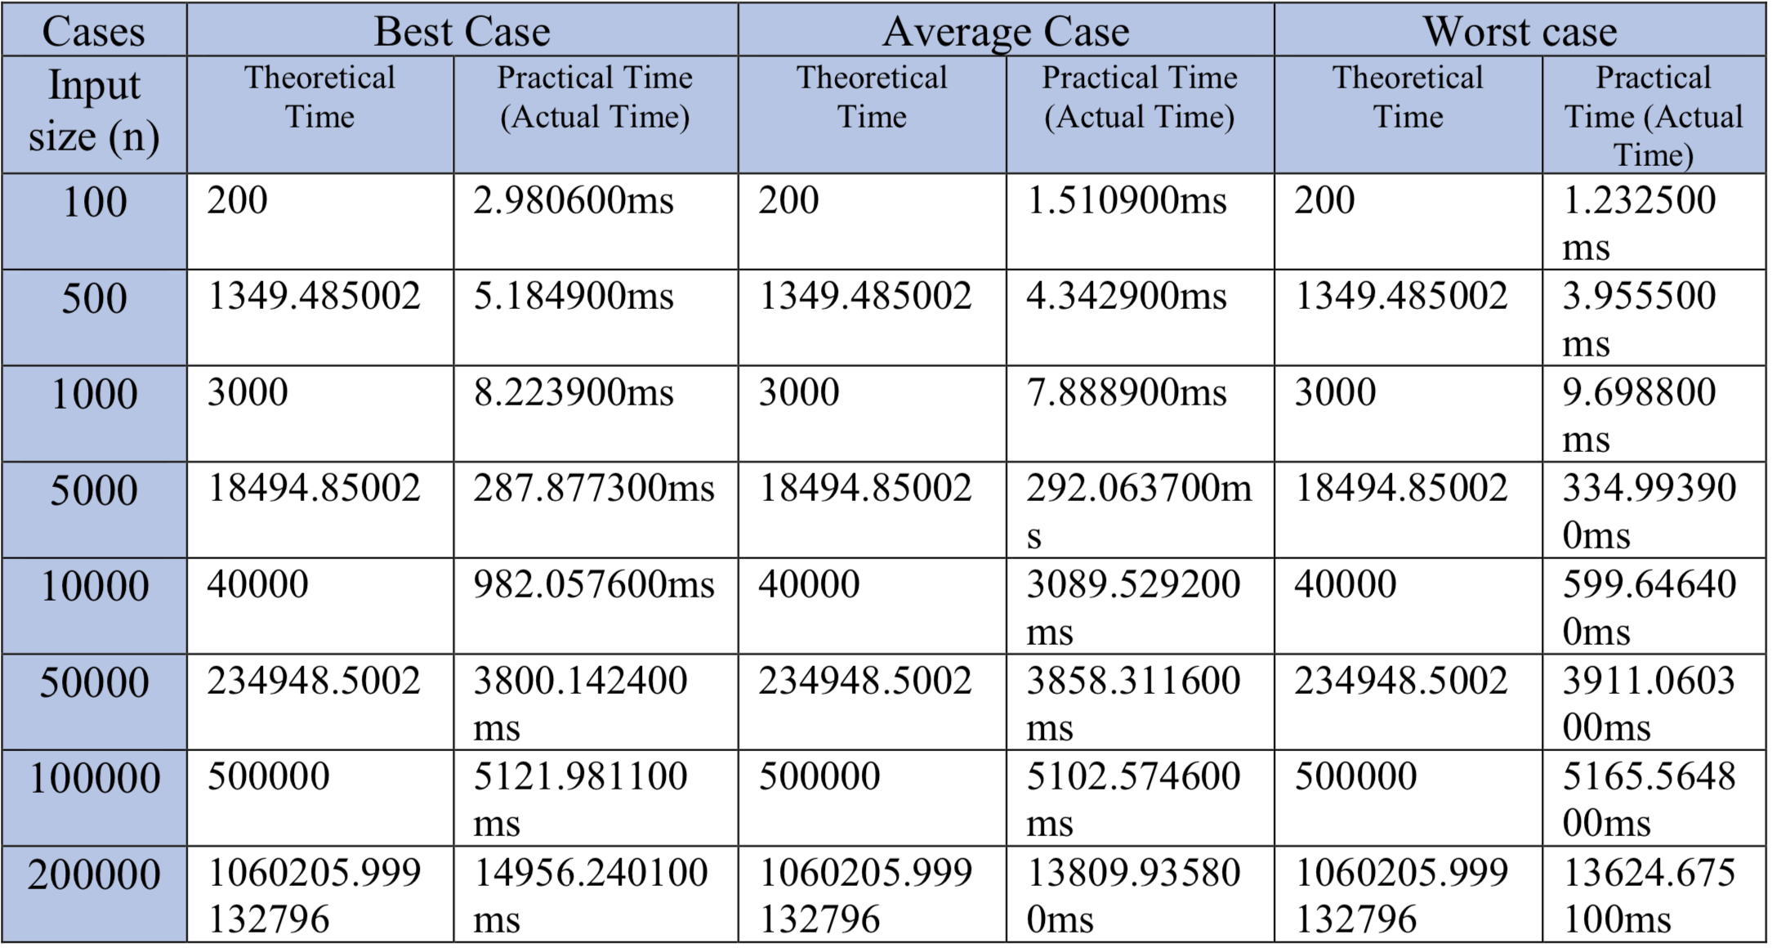
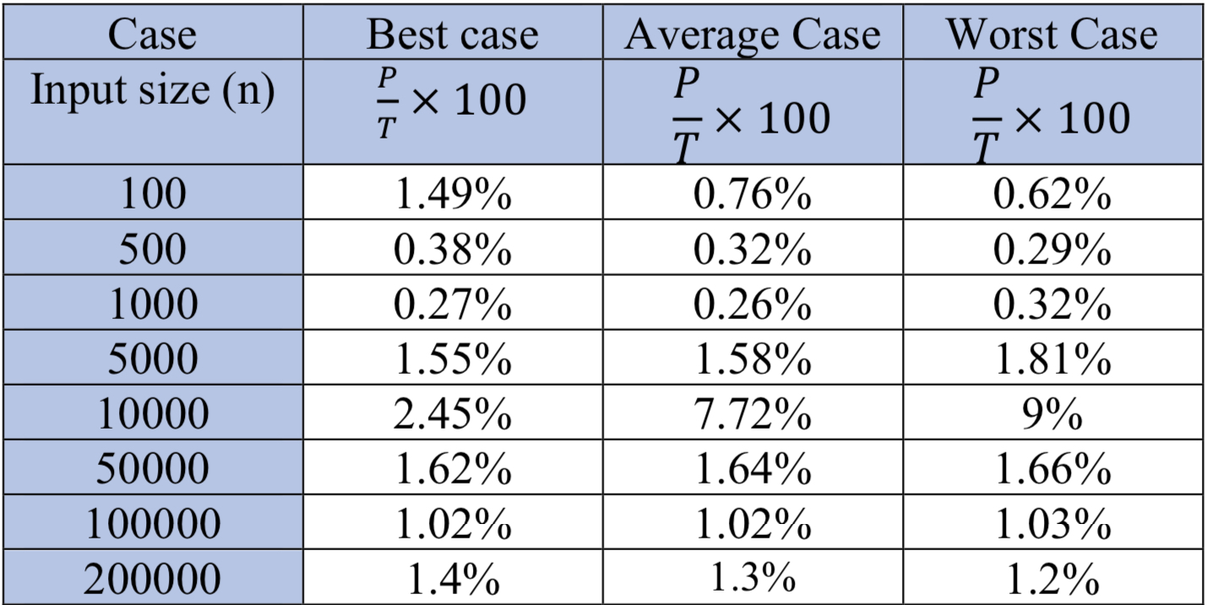
Heap Sort Algorithm’s Theoretical and Practical Analyze and Error Ratio

Slide 16
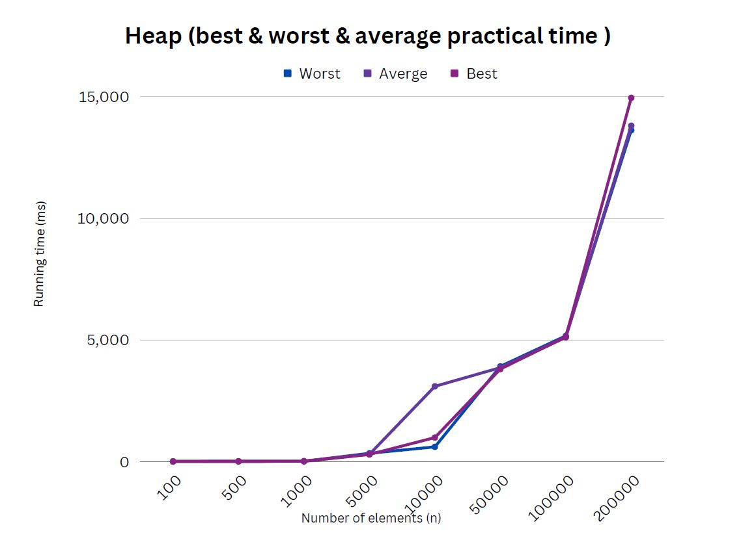
Heap Sort Algorithm’s Cases Comparison Graph

Slide 17
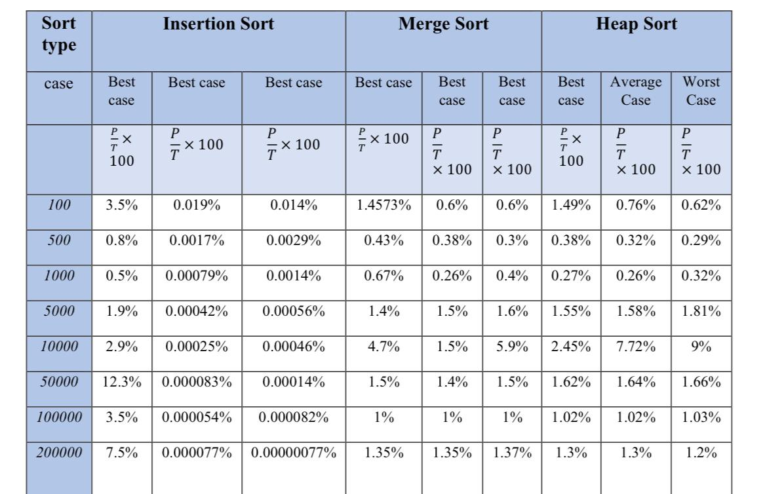
Sorting Algorithms Comparison Table

Slide 18
Sorting Algorithms Comparison Graph for best case

Slide 19
Sorting Algorithms Comparison Graph for average case

Slide 20
Sorting Algorithms Comparison Graph for worst case

Slide 21
Number of comparisons VS execution time
For the comparison sorts, is the number of comparisons really a good predictor of the execution time?
Comparison Number Equation:
Insertion Sort: (n^2 /2)
Merge Sort: (n log n)
Heap Sort: (n log n)
Input size:
(100, 500, 1000, 5000, 10000, 50000, 100000, 200000)
Table :
Input sizes
Number of Comparison results
Execution time results
Graphs:

Slide 22
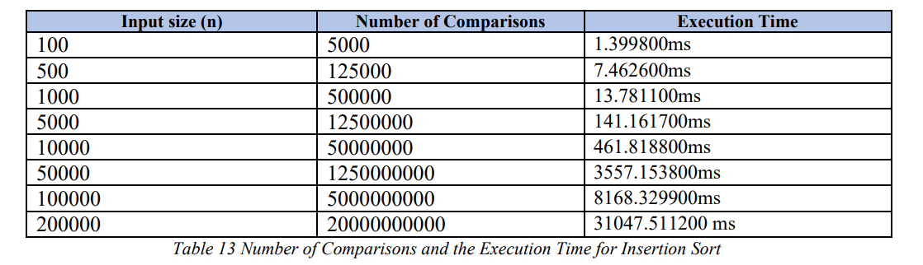
number of comparisons VS execution time
For example :
The Number of Comparisons and the Execution Time for Insertion Sort: (n^2 /2)

Slide 23
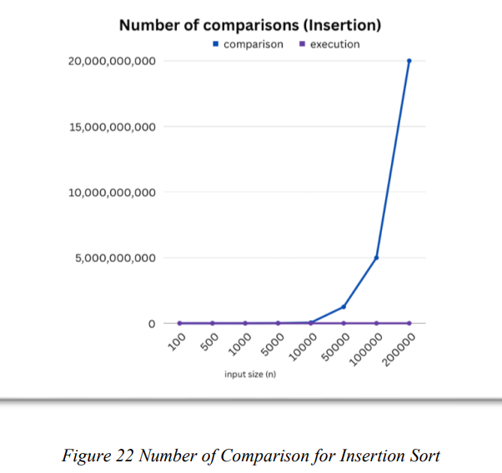
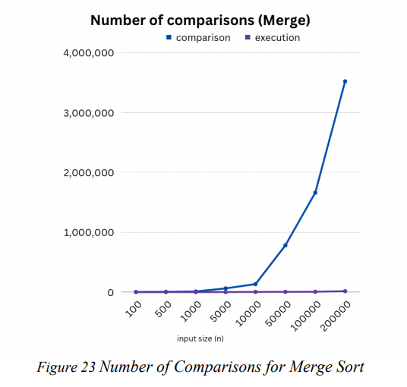
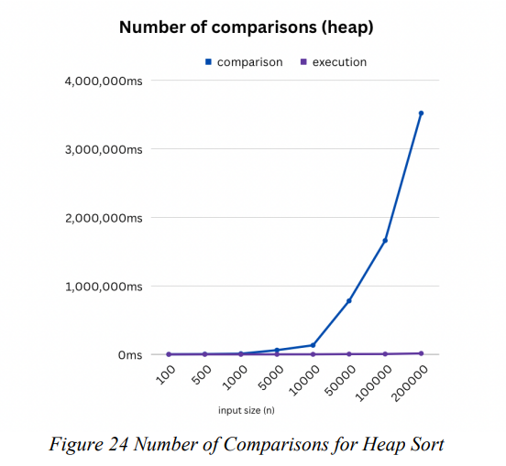
number of comparisons VS execution time
For example :
The Number of Comparisons and the Execution Time for insertion, merge and heap

Slide 24
Problem Solving and Analysis

Slide 25
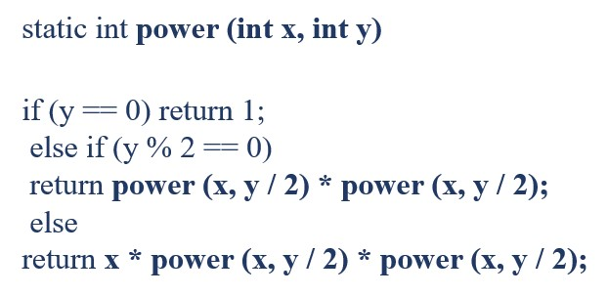
Design and analysis an improved Divide-and-conquer algorithm compute a^n
Design and analysis an improved Divide-and-conquer algorithm compute 𝑎𝑛 , where n is natural number. Given two integers a and n, an algorithm is written to solve this problem and give the best running time possible.
Practical code in java (Improved Divide-And-Conquer)

Slide 26
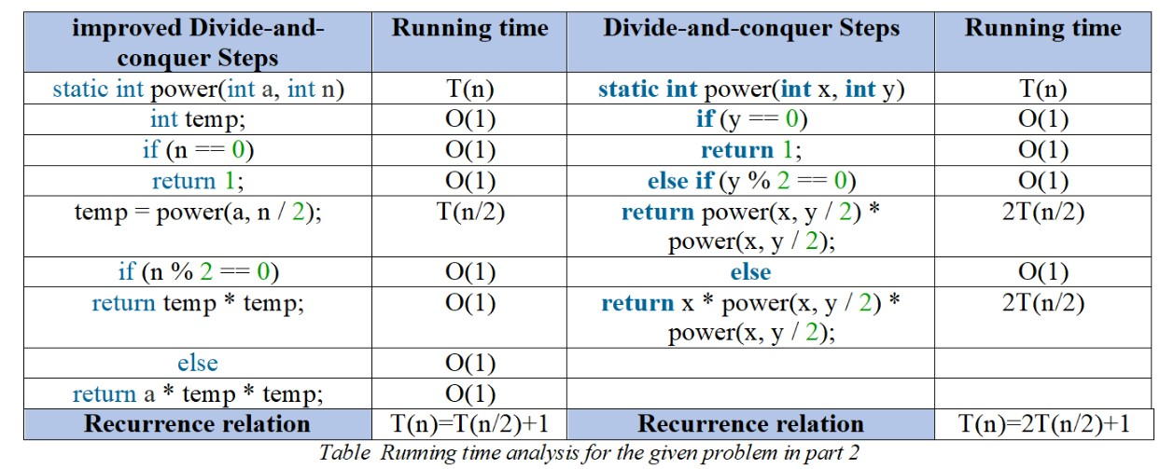
Running time analysis
T(n)= O (log2 n) T(n)= O (n)

Slide 27
Discussion

Slide 28


Thank You For Listening

